Slide 1
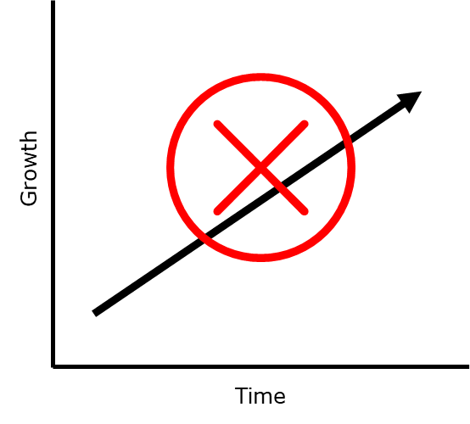
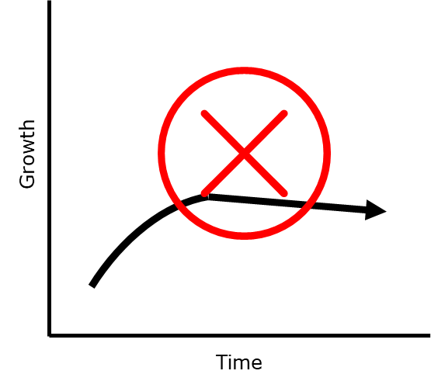
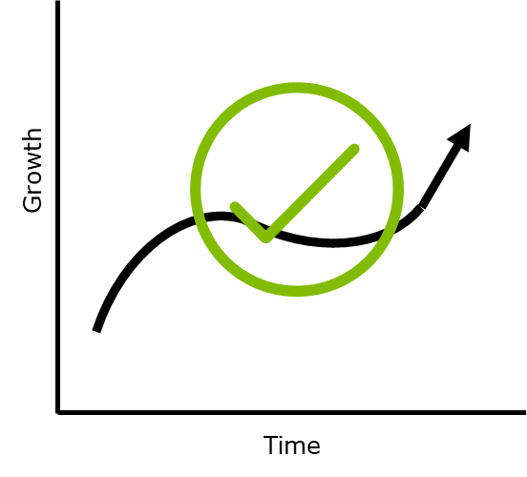
Job Aid: How to Tell a From-To Story
Before you ENGAGE, consider this…
Every story has a beginning, a middle, and an end. The Growth Model looks at professional development in the same way. The beginning is where we are now, and the end is where we want to be. We want to go FROM the beginning TO the end. However, in the middle the main character has to work through unexpected challenges. Here are some things to keep in mind to help your people make it through their story:
Clarify where they want to get TO
1. Ask them what their goals are?
2. Use questions like, “Where would you like to be in two years? When you reflect back on your career how will you want to be remembered and talked about?”
“Too Confident”
When someone’s story is too positive, they may not be ready for pitfalls. Help them craft a story that includes unexpected challenges.
Clarify where they are starting FROM
1. Ask them to assess their current capability level and how far they are from their goal.
2. Help them discuss their ideas and decide what to work on. Make sure 70% of the conversation is them talking about their ideas (only 30% should be you).
“Too Pessimistic”
When someone’s story is too negative, they may become de-motivated and their growth may stall. Help them craft a story that shows pitfalls can be overcome.
Ask them how they can get there.
1. Ask them to describe the journey from where they are now, to where they want to be.
2. Make sure they include both what will go well and what challenges they may face.
Listen and play their story back for them.
1. How do they describe their progress? Do they sound confident that it will be steady and continuous? Do they sound pessimistic, making it sound difficult or impossible?
2. If needed, reflect something slightly different back to them that sounds more like the realistic / resilient story arc. (See the graphic at right and the deep dive on the second page of this job aid.)
“Realistic/Resilient”
When someone’s story reflects both the challenge and the way out, they are much better prepared to grow over the long term. Help them craft a story that embraces the ups and downs and levels out the bumps over time.
Coach them through pitfalls, using them as growth opportunities.
1. Your goal is to show people how to tell these stories to themselves.
2. If you do that, you will help them overcome specific developmental challenges.
3. You will also build their confidence to keep going through any challenge.

Slide 2
Job Aid: How to Tell a From-To Story
Before you ENGAGE, consider this…
As you coach your team members, a story will emerge. The type of story that emerges will impact how well they deal with challenges in their growth efforts. In order to foster realistic, resilient growth, the story needs to “go all the way down and come all the way back up again.” Watch out for these three common story arcs, and try to shape them into the “realistic/resilient” type.
“Too Confident”
“Too Pessimistic”
“Realistic/Resilient”
Tips for coaching someone whose story reflects overconfidence.
Don’t undermine their confidence but help them to be realistic.
Plant seeds early that unexpected challenges will occur.
Prepare them for disappointment if things do go wrong.
Provide examples of people who had to change direction or re-think their expectations to bounce back.
Tips for coaching someone whose story is “too pessimistic”:
Be patient and don’t shame or belittle them.
Listen for black-and-white statements about why they can’t improve.
Use questions to shift their focus on what they can control and what impact they want to have in their role.
Tips for coaching someone to tell growth stories that are “realistic and illustrate resilience”
Show compassion and patience when they hit a “pitfall” in their growth story.
Help them own the problem, and use questions to drive creative thinking about ways to solve it.
Ask questions to help shift their thinking and try new ideas.
Celebrate successes publicly and build momentum with approaches that work.

